Slide 1
Randomized Algorithms CS648A
Lecture 8
Randomized Primality Checking
The mystery behind design of randomized algorithms
Approximate Distance Oracles.
Almost complete

Slide 2
Randomized algorithm for Primality

Slide 3


Using simple modular arithmetic
$p$ : a prime number
(Fermat’s little theorem)
If $p$is prime then for each $a<p$,
$a^{p−1}mod p=1$.
Question: What if $p$is composite ?
For each $a<p$, $a^{p−1}mod p≠ 1$.

Slide 4
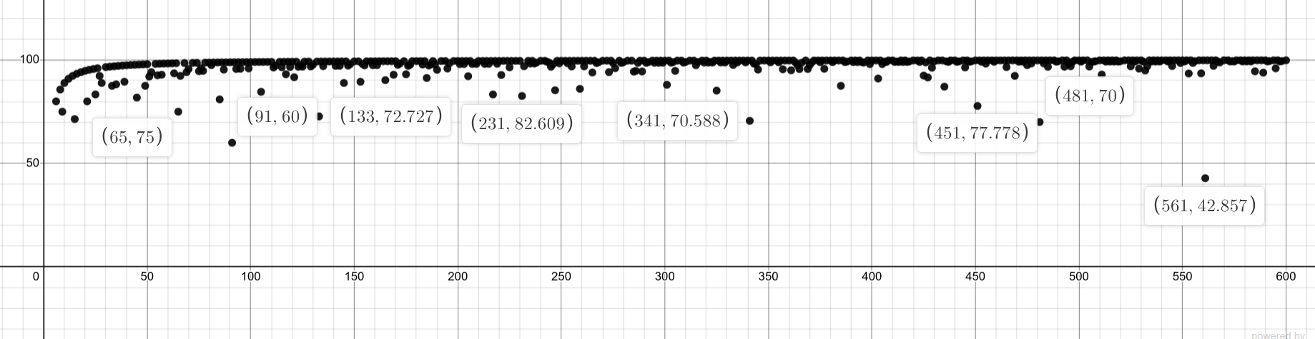
Plot for composite numbers
For composite numbers from 6 to 600
y value for a composite number $n$represents the following:
the percentage of numbers $a<n$ such that$a^{n−1}mod n≠ 1$.

Slide 5


$n$: composite number
$A$: {$1,2,…,n−1$}
$A_{fermat}$: set of numbers $a∈A$such that $a^{n−1}mod n≠ 1$
Question:
Can we get a worst case guarantee on $\frac{\left|A_{fermat}\right|}{|A|}$ ?

Slide 6





$n$: composite number
$A$: {$1,2,…,n−1$}
set of elements $a∈A$ s.t. gcd($a,n$)$=1$
set of elements $a∈A$ s.t. gcd($a,n$)$≠1$
$$⊂^{?}A_{fermat}$$
$$⊂A_{fermat}$$

Slide 7




Plot created by Avi and Harsh
$A$: {$1,2,…,560$}
set of elements $a∈A$ s.t. gcd($a,n$)$=1$
$$⊓A_{fermat}$$
$$=∅$$

Slide 8



$n$: composite number
$A$: {$1,2,…,n−1$}
set of elements $a∈A$ s.t. gcd($a,n$)$=1$
$$a^{n−1}mod n= 1$$
$$a^{n−1}mod n≠ 1$$

Slide 9







$n$: composite number
$A$: {$1,2,…,n−1$}
${\left(\left(u⋅v\right)mod n\right)}^{n−1} mod n$
= ${\left(u⋅v\right)}^{n−1}$mod $n$
= $(u^{n−1}mod n⋅v^{n−1}mod n)$mod $n$
= $(1⋅v^{n−1}mod n)$mod $n$
= $v^{n−1}mod n$
$≠$1
$\left(u⋅v\right)mod$ $n$
$$∈$$
set of elements $a∈A$ s.t. gcd($a,n$)$=1$
$$v$$
$$u$$
$$u^{n−1}mod n= 1$$
$$v^{n−1}mod n≠ 1$$

Slide 10



$n$: composite number
$A$: {$1,2,…,n−1$}
$\left(u⋅v\right)mod$ $n$ = $\left(w⋅v\right)mod$ $n$
$n$ divides $(\left(u−w)⋅v\right)$
$u=w$
$\left(u⋅v\right)mod$ $n$
$$∈$$
set of elements $a∈A$ s.t. gcd($a,n$)$=1$
$\left(w⋅v\right)mod$ $n$
$$v$$
$$u$$
$$w$$

Slide 11
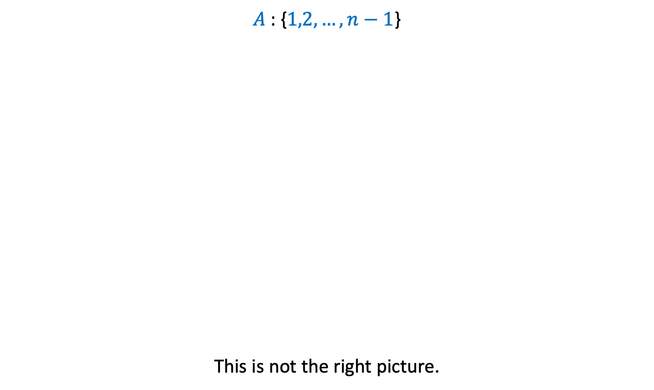
$n$: composite number
$A$: {$1,2,…,n−1$}
This is not the right picture.
set of elements $a∈A$ s.t. gcd($a,n$)$=1$
$$a^{n−1}mod n= 1$$
$$a^{n−1}mod n≠ 1$$

Slide 12
$n$: composite number
$A$: {$1,2,…,n−1$}
set of elements $a∈A$ s.t. gcd($a,n$)$=1$
$$a^{n−1}mod n= 1$$
$$a^{n−1}mod n≠ 1$$
Carmichael numbers
Non-Carmichael numbers
Ponder over ways to handle them ☺ for 2 months

Slide 13
A very very important question
At this juncture of the course

Slide 14
Randomized Algorithms discussed till now
Randomized algorithm for Approximate Median
Randomized Quick Sort
Frievald’s algo. for Matrix Product Verification
Randomized algorithm for Equality of two files
Randomized algorithm for Pattern Matching
Randomly select a sample
Randomly select the pivots
Randomly select a vector
Randomly select a prime number
Randomly select a prime number

Slide 15

Randomized Algorithms
How does one go about designing a randomized algorithm ?

Slide 16
Randomized Algorithms
Some random idea is required to design a randomized algorithm.
Let us carefully look at the randomized algorithms discussed till now.

Slide 17
Randomized Quick Sort

Slide 18

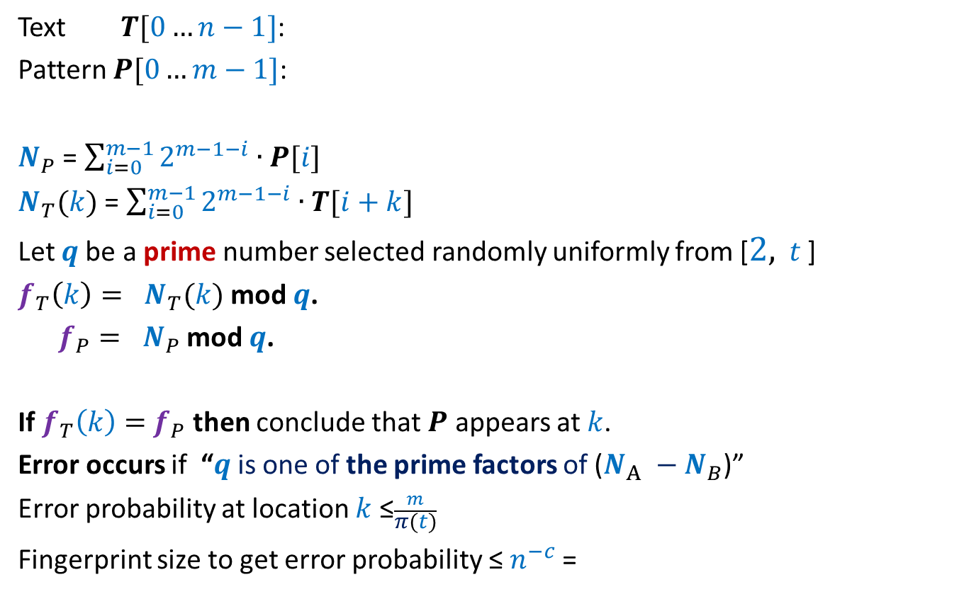
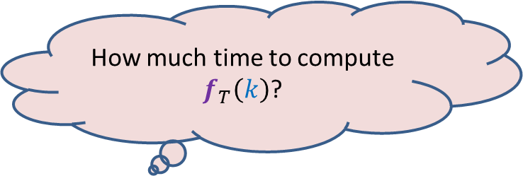

Randomized Quick Sort
$1$ …
$$n$$
A
Elements of A arranged in Increasing order of values
pivot
$$n/4$$
$${3n}/4$$

Slide 19

Randomized Quick Sort
Observation: There are many elements in A that are good pivot.
Is it possible to select one good pivot efficiently ?
(not possible deterministically ☹)
We select pivot element randomly uniformly.
A randomly selected element is a good pivot with probability $\frac{1}{2}$

Slide 20
Randomized Algorithm for Approximate median

Slide 21
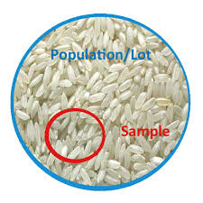
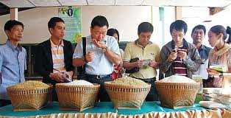
Randomized Algorithm for Approximate median
A random sample captures the essence of the original population.

Slide 22
Randomized Algorithm for Approximate median
Idea: Is it possible to select a small sample of elements
whose median approximates the median ?
(not possible deterministically ☹)
Median of a uniformly random sample will be approximate median w.h.p.
A random sample captures the essence of the original population.

Slide 23
Checking Equality of Files
By transmitting least number of bits

Slide 24






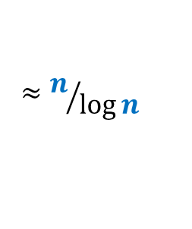
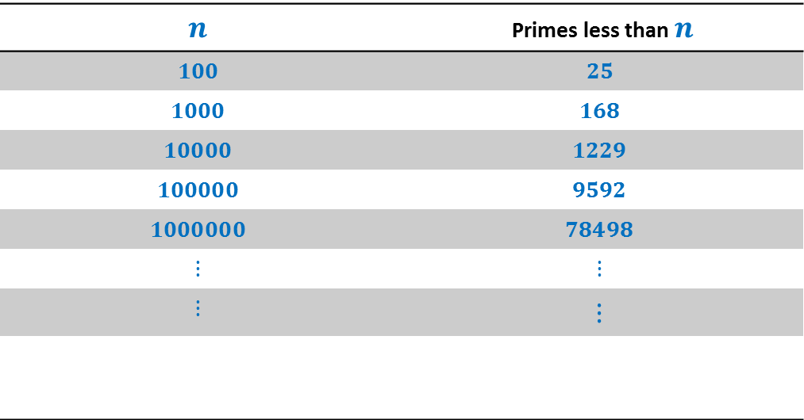

How many primes less than $n$ ?
$$n$$ | Primes less than $n$
$$100$$ | $$25$$
$$1000$$ | $$168$$
$$10000$$ | $$1229$$
$$100000$$ | $$9592$$
$$1000000$$ | $$78498$$
$$⋮$$ | $$⋮$$
$$⋮$$ | $$⋮$$
$π\left(n\right)$:
$$π\left(n\right)$$
$$≈n/{\log{n}}$$
Huge gap
How many prime factors of $n$ ?
$$<\log{n}$$
Observation:
Majority of prime numbers from a [2, $c \log^{2}⁡$ $n$]
are unlikely to be a prime factor of $n$
Notes:
Randomization will exploit this huge difference to achieve a very simple and elegant algorithm.

Slide 25
Randomized Algorithms
An idea based on insight into the problem
Difficult/impossible to exploit the idea deterministically
A randomized algorithm
Randomization to materialize the idea
The following slide conveys a very important message.

Slide 26

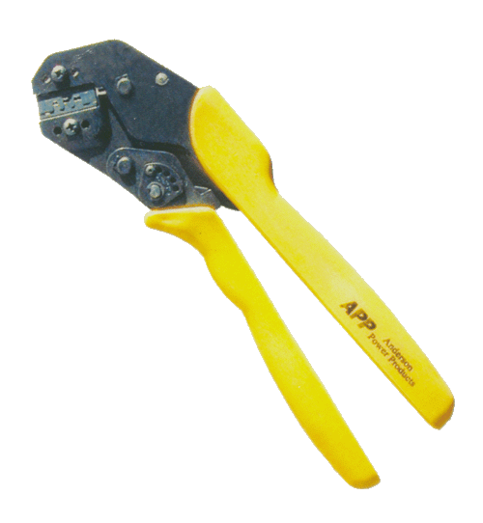
Randomization
Greedy strategy
Dynamic programming
Divide and conquer
Tools for designing algorithms
But what matters the most in designing an efficient algorithm is …
INSIGHT of a problem

Slide 27
Frievald’s Technique Application matrix product verification
Homework:
What is the key idea ?
How does randomization help to materialize it ?

Slide 28
Approximate Distance oracles

Slide 29
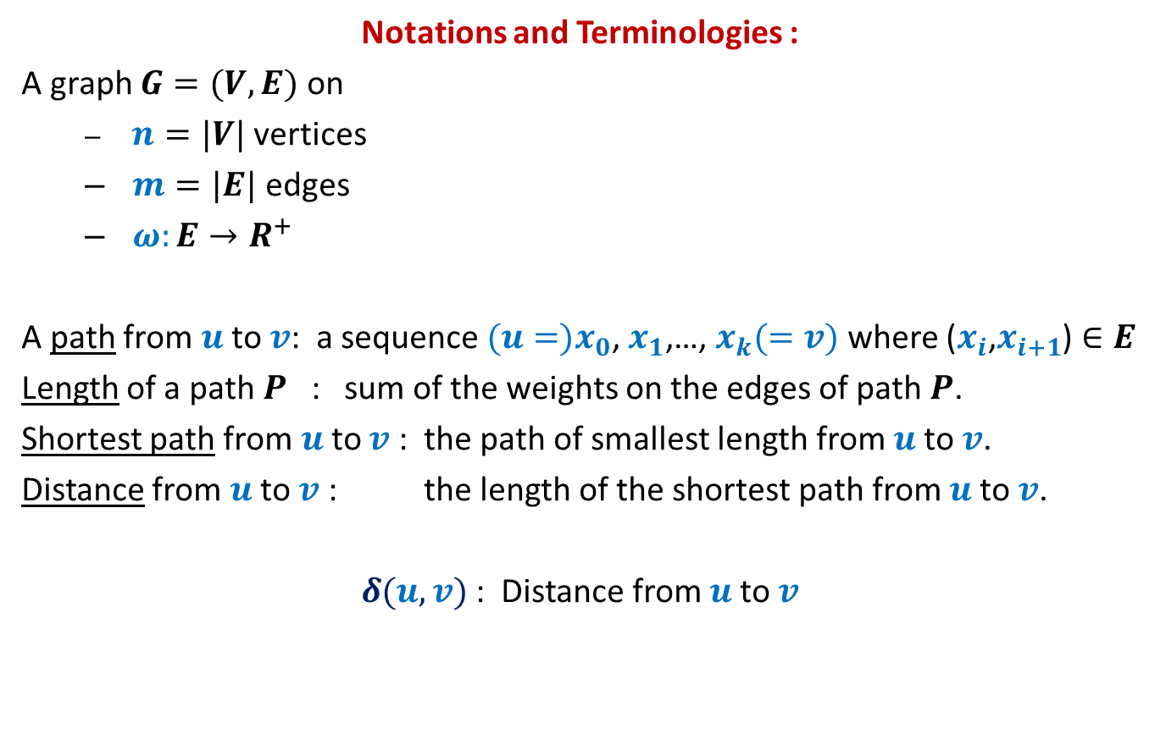
All-Pairs Shortest Paths
Notations and Terminologies :
A graph $G=(V,E)$ on
$n=|V|$ vertices
$m=|E|$ edges
$ω:E→R^{+}$
A path from $u$to $v$: a sequence ${(u=)x}_{0}$, $x_{1}$,…, $x_{k}(=v)$ where ($x_{i}$,$x_{i+1}$) $∈E$
Length of a path $P$ : sum of the weights on the edges of path $P$.
Shortest path from $u$to $v$ : the path of smallest length from $u$to $v$.
Distance from $u$to $v$ : the length of the shortest path from $u$to $v$.
$δ(u,v)$ : Distance from $u$to $v$

Slide 30
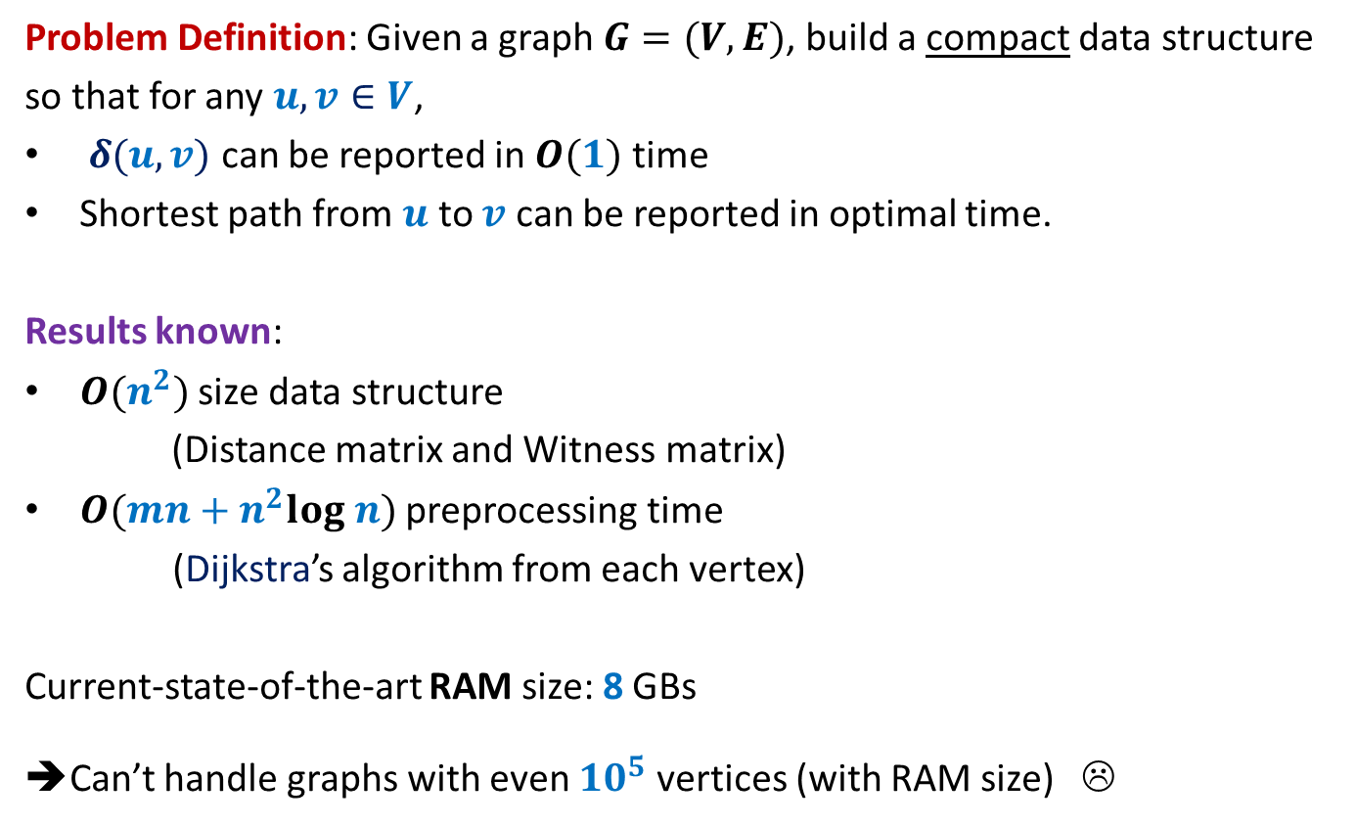
All-Pairs Shortest Paths
Problem Definition: Given a graph $G=(V,E)$, build a compact data structure
so that for any $u,v∈V$,
$δ(u,v)$ can be reported in $O(1)$ time
Shortest path from $u$ to $v$ can be reported in optimal time.
Results known:
$O(n^{2})$ size data structure
(Distance matrix and Witness matrix)
$O(mn+n^{2}log n)$ preprocessing time
(Dijkstra’s algorithm from each vertex)
Current-state-of-the-art RAM size: 8 GBs
➔Can’t handle graphs with even ${10}^{5}$ vertices (with RAM size) ☹

Slide 31
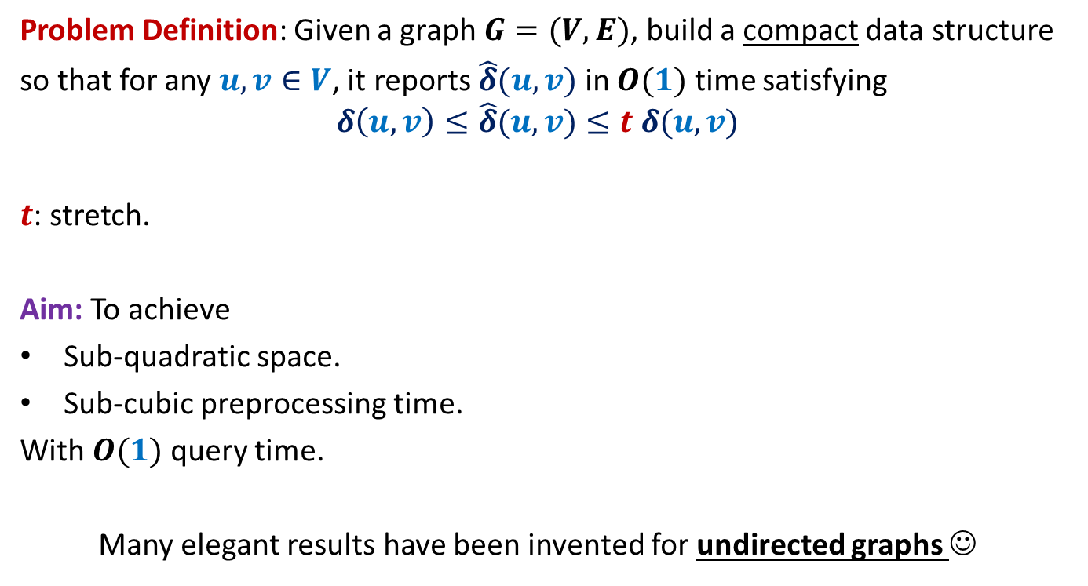
All-Pairs Approximate Shortest Paths
Problem Definition: Given a graph $G=(V,E)$, build a compact data structure
so that for any $u,v∈V$, it reports $\hat{δ}(u,v)$ in $O(1)$ time satisfying
$$δ\left(u,v\right)≤\hat{δ}(u,v)≤t δ(u,v)$$
$t$: stretch.
Aim: To achieve
Sub-quadratic space.
Sub-cubic preprocessing time.
With $O(1)$ query time.
Many elegant results have been invented for undirected graphs ☺

Slide 32





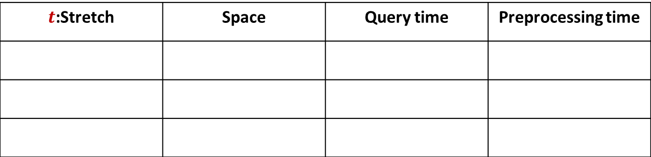







A truly magical result
Approximate Distance Oracles
$t$:Stretch | Space | Query time | Preprocessing time
$$3$$
$$O(n^{1+\frac{1}{2}})$$
$$O(1)$$
$$O({mn}^{\frac{1}{2}})$$
$$5$$
$$O(n^{1+\frac{1}{3}})$$
$$O(1)$$
$$O({mn}^{\frac{1}{3}})$$
$$2k−1$$
$$O(n^{1+\frac{1}{k}})$$
$$O(k)$$
$$O({k mn}^{\frac{1}{k}})$$
Mikkel Thorup and Uri Zwick:
Approximate Distance Oracles for graphs,
Journal of ACM (4), 2005

Slide 33
Inspiration from our daily life

Slide 34
Part I
Key insight underlying Approximate Distance Oracle

Slide 35
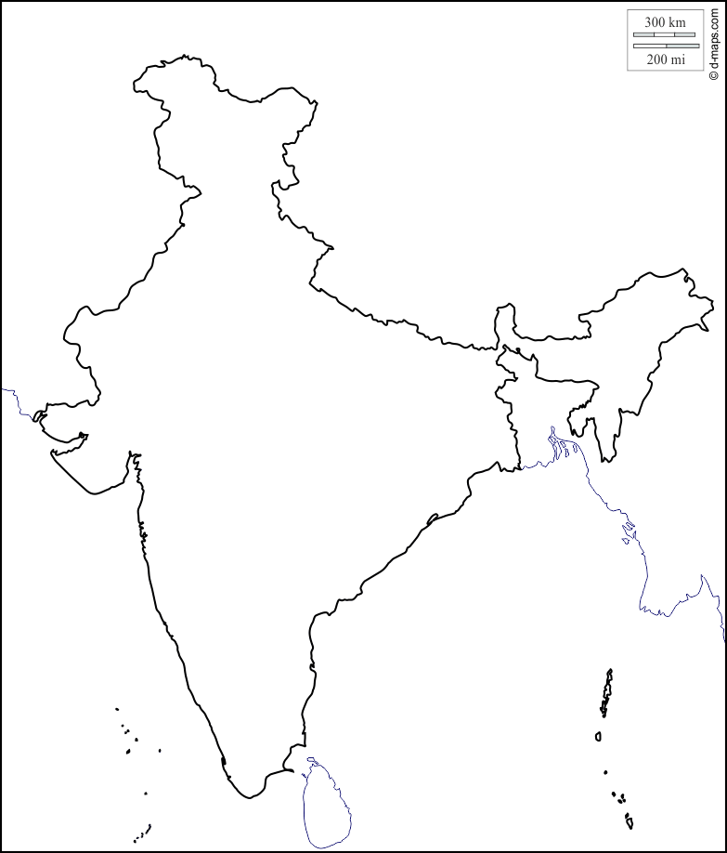

Key insight underlying Approximate Distance Oracle
$$Kanpur$$

Slide 36





Key insight underlying Approximate Distance Oracle
$$Rohtak$$
$$Lucknow$$
$$Delhi$$
$$Kanpur$$
$$Fatehpur$$

Slide 37

Idea to achieve subquadratic space
$$V$$

Slide 38


Idea to achieve subquadratic space
Since |$L$| is small, ➔
we can afford to store distance from each $u∈L$ to every other vertex.
From each vertex $u∈V\backslash L$,
store distance to vertices present in its locality
$$L$$
. . . . . . . . . .
$$V$$

Slide 39

Formal notion of locality
$$u$$

Slide 40



Formal notion of locality
$Ball(u,V,L)$= {$x∈V| δ\left(u,x\right)<δ\left(u,L(u)\right)$}
$$L(u)$$
$$u$$
$$Ball(u,V,L)$$

Slide 41

The Idea
Given a graph $G=(V,E)$,
Compute a small set $L$ of Landmark vertices.
From each vertex $u∈V\backslash L$, store distance to vertices present in its locality.
From each vertex $v∈L$, store distance to all vertices in the graph.
Questions:
What is the formal notion of locality ?
How to retrieve distance from $u$ to a far away vertex ?
What is the guarantee of stretch ?
How to compute the desired set $L$ efficiently ?

Slide 42





Reporting distance from $u$
Report $δ\left(u,L(u)\right)+δ\left(L(u),v\right)$
$$δ\left(u,L(u)\right)≤δ\left(u,v\right)$$
$$v$$
$$v$$
$$L(u)$$
$$u$$
$$Ball(u,V,L)$$

Slide 43



What is the stretch ?
stretch $≤3$
$$δ\left(u,L(u)\right)≤δ\left(u,v\right)$$
??
$$≤δ\left(u,v\right)+δ\left(u,L(u)\right)$$
$≤2δ\left(u,v\right)$
$$v$$
$$L(u)$$
$$u$$
$$Ball(u,V,L)$$

Slide 44
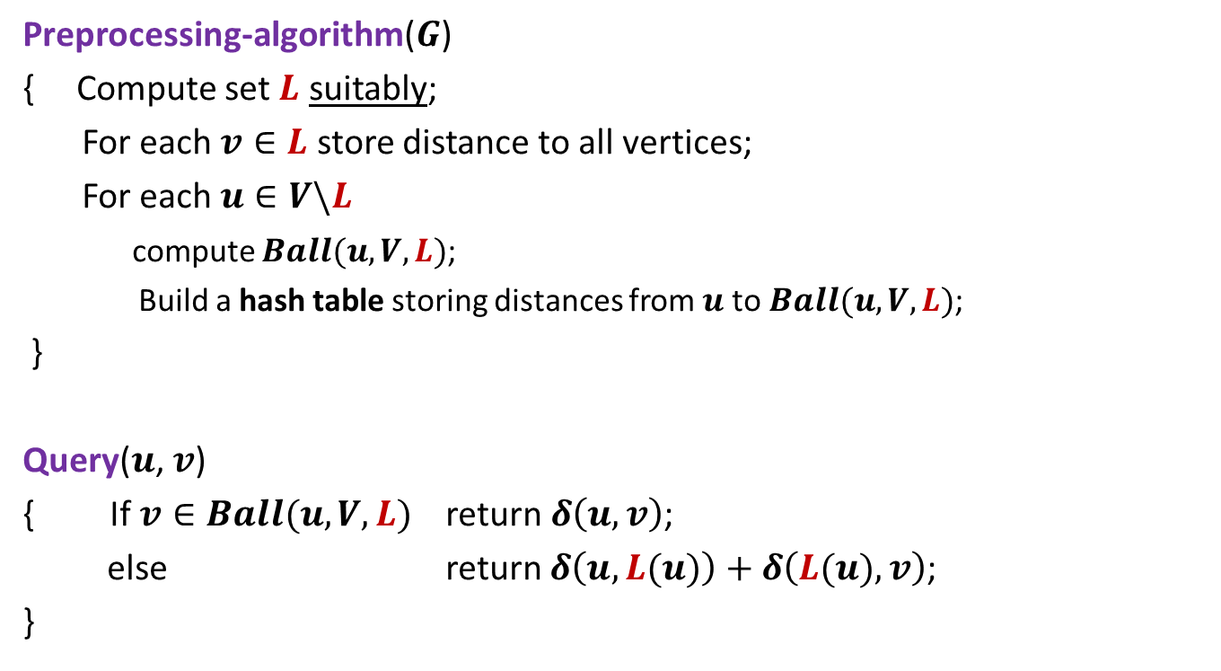
3-approximate distance oracle
Preprocessing-algorithm($G$)
{ Compute set $L$ suitably;
For each $v∈L$ store distance to all vertices;
For each $u∈V\backslash L$
compute $Ball(u,V,L)$;
Build a hash table storing distances from $u$to $Ball(u,V,L)$;
}
Query($u$, $v$)
{ If $v∈Ball(u,V,L)$ return $δ\left(u,v\right)$;
else return $δ\left(u,L(u)\right)+δ\left(L(u),v\right)$;
}
Global distance info.
Local distance info.

Slide 45
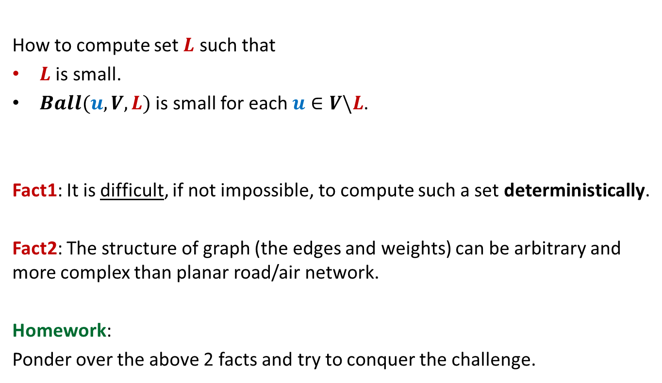
The real challenge left
How to compute set $L$ such that
$L$ is small.
$Ball(u,V,L)$ is small for each $u∈V\backslash L$.
Fact1: It is difficult, if not impossible, to compute such a set deterministically.
Fact2: The structure of graph (the edges and weights) can be arbitrary and more complex than planar road/air network.
Homework:
Ponder over the above 2 facts and try to conquer the challenge.

